Slide 1


Analyst Presentation
November 2008
CD Tools - Basic
Training
Confidential Company Overview & Update DRAFT
November 2008
Notes:
Adapt the footer as follows:
Select ‘Insert’ on the top menu
Select the ‘Header&Footer’ button
Tick ‘Date and time’
Tick ‘Update automatically’
Select e.g. ‘Aug-08’ as the format
Tick ‘Slide number’
Tick ‘Footer’
Insert the presentation name in the
text field below the ‘Footer’ tick field
Select ‘Apply to All’
The Slide Master does NOT need to be touched! If you delete footer text boxes on the Slide Master, the ‘Insert’ – ‘Header&Footer’ will not work.

Slide 2





Release Management
RM’s objective is to…..
Provide a structured approached to rolling out new software to customers
Minimizes the impact of changes to environments
Ensure testing and documentation has occurred prior to rollout
Serve as the only role for distribution of any release, internal and external – to include sending & receiving from 3rd Parties
CD Tools – GIT Installation
Landis+Gyr Confidential Information

Slide 3
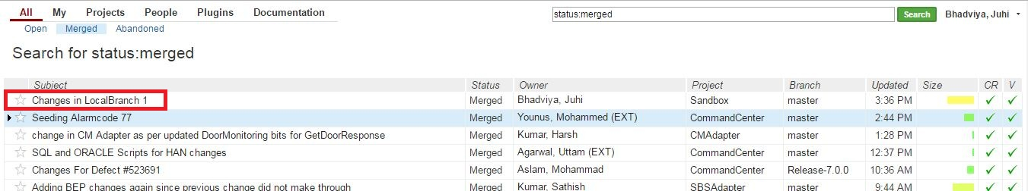
Cherry pick
Cherry-pick applies the changes of a commit to a different branch of same project.
Go to All > Merged.
Select the commit whose changes you want to cherry pick to another branch.
Note : You must never cherry-pick changes that are still in review (status is not merged).
Landis+Gyr Confidential Information

Slide 4
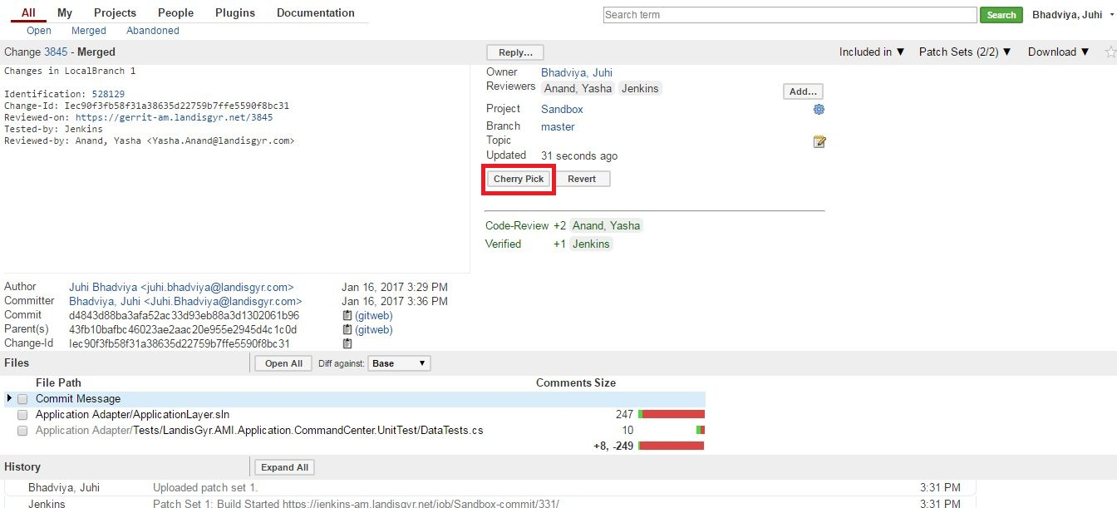
Click on Cherry Pick. ** The commit currently exists for master branch. **
Landis+Gyr Confidential Information

Slide 5
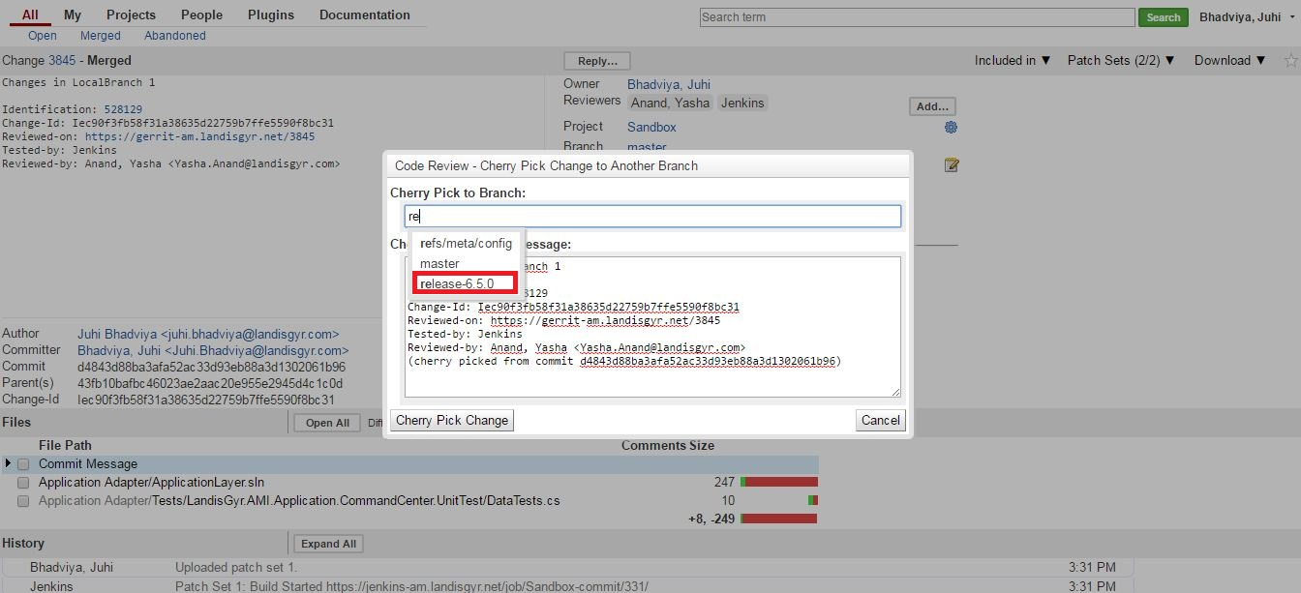
Specify Cherry Pick to Branch (say, release-6.5.0 branch).
Click on Cherry Pick Change.
Landis+Gyr Confidential Information

Slide 6
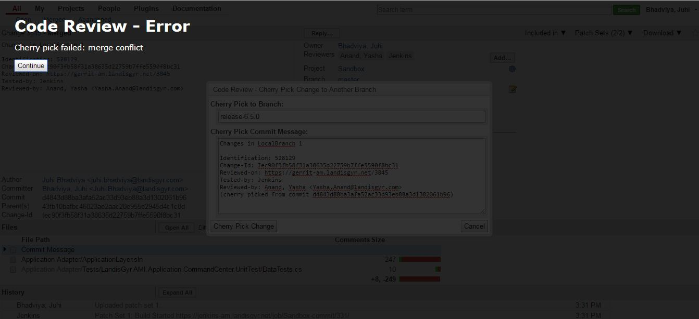
If there are Merge Conflicts, you will get below error
Click Continue.
Landis+Gyr Confidential Information

Slide 7
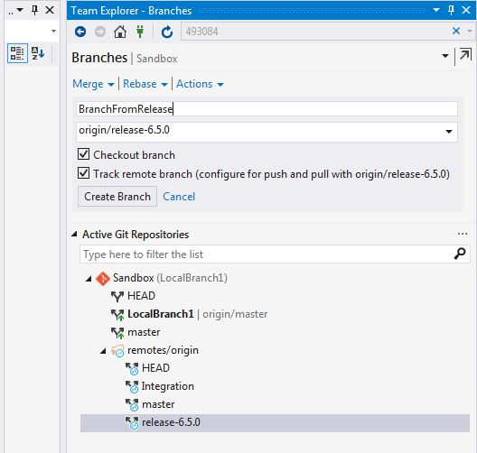
Create a new Branch (say BranchFromRelease) from the Branch to which you want to Cherry Pick your changes (say release-6.5.0 branch).
Make BranchFromRelease as your ACTIVE branch (Its should be visible in bold)
Landis+Gyr Confidential Information

Slide 8
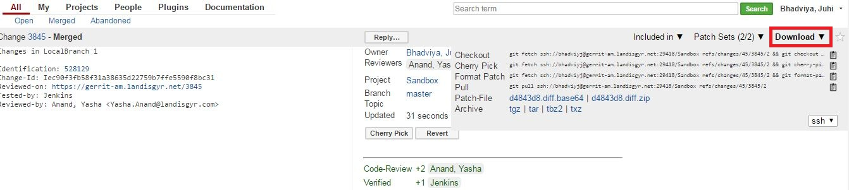
In Gerrit, Click on Download as pointed.
For checkout option, click on Copy to Clipboard icon (as highlighted).
Landis+Gyr Confidential Information

Slide 9
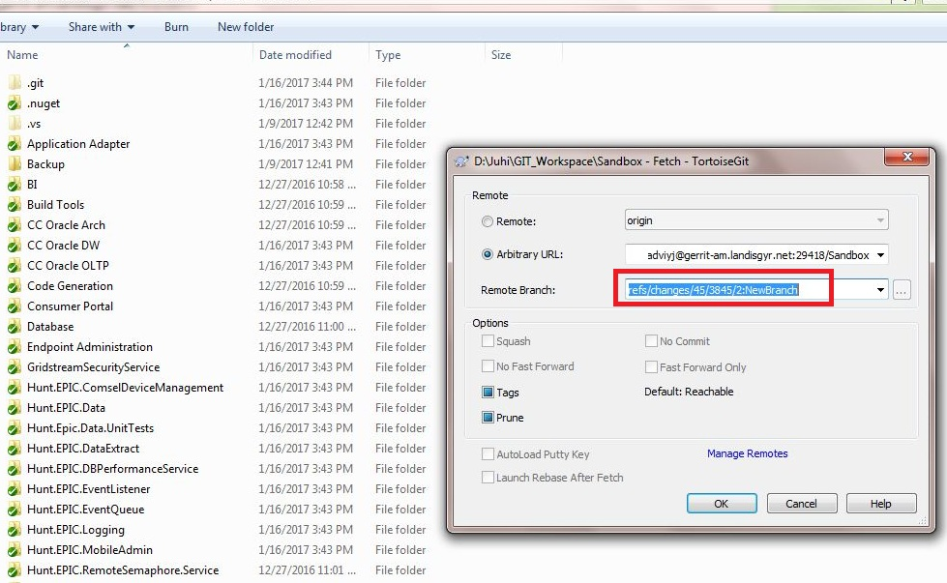
Fetch to get the latest code
Click on Arbitrary URL.
The field will be automatically updated if the download link is copied to clipboard.
Remote branch will also be updated automatically. You will need to add the name of your local branch –(Say, New Branch)
Landis+Gyr Confidential Information

Slide 10
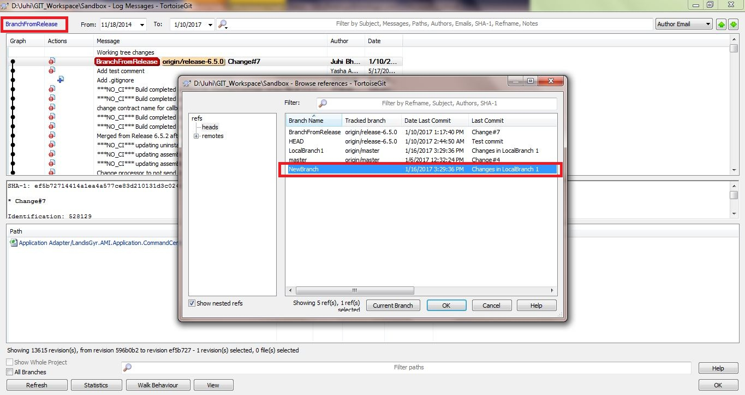
Right Click and select Show Log.
Select Branch name ‘NewBranch’ from upper left corner as shown.
Landis+Gyr Confidential Information

Slide 11
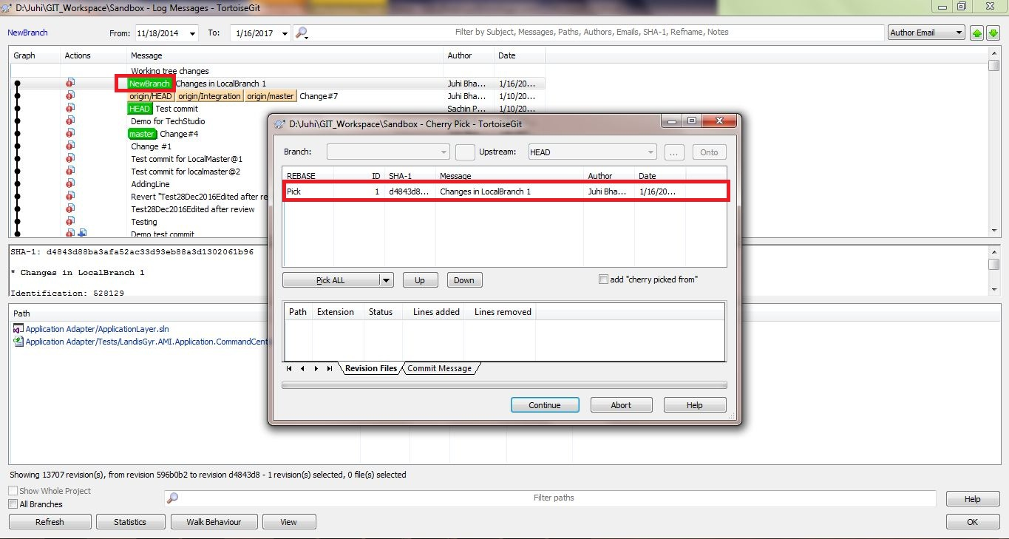
Right Click on ‘NewBranch’ and select Cherry Pick this commit.
Select the changes and Continue.
Landis+Gyr Confidential Information

Slide 12
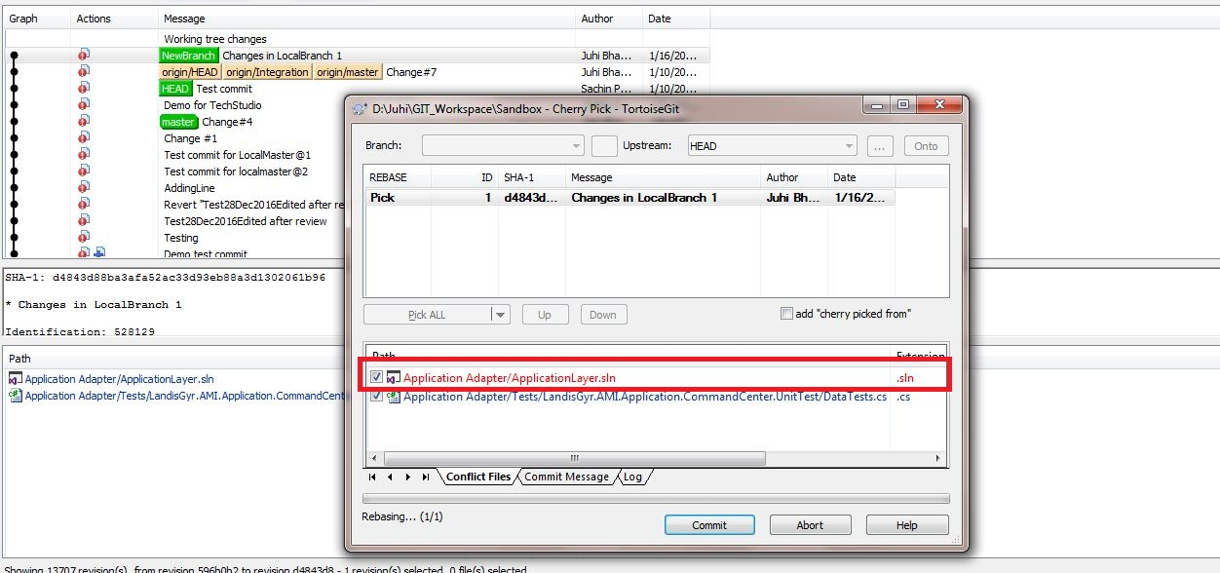
Conflicted files will be shown in Red. Double Click on the file.
Landis+Gyr Confidential Information

Slide 13
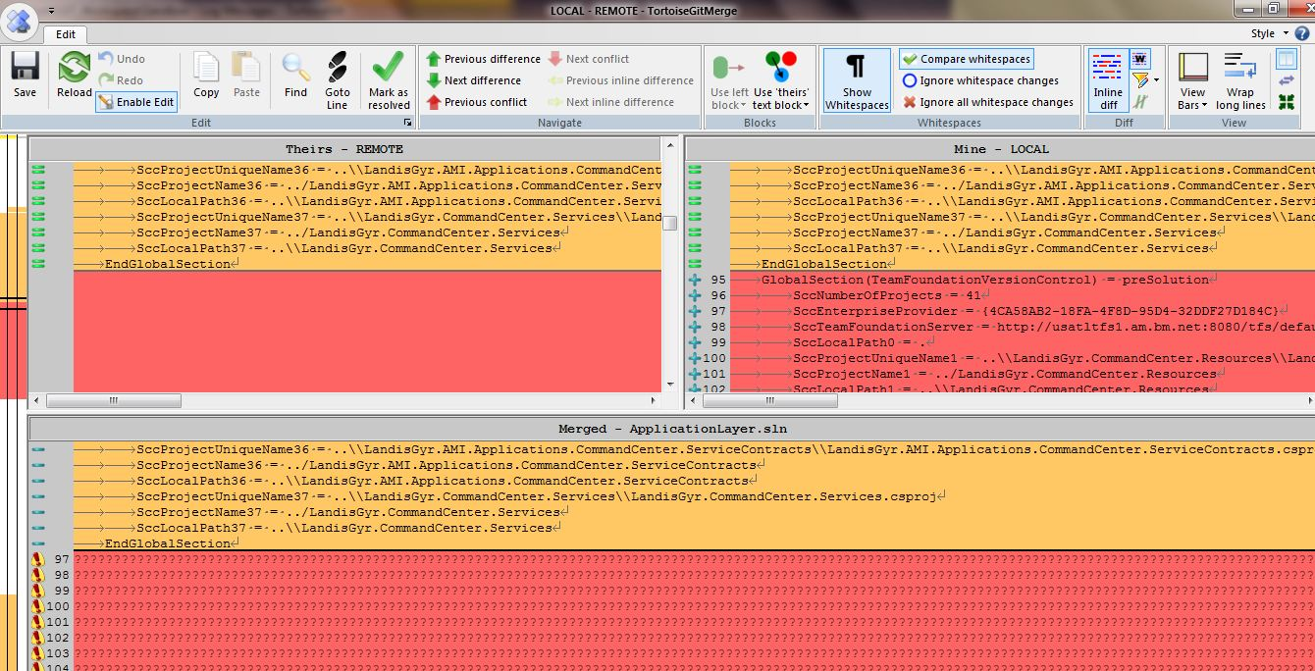
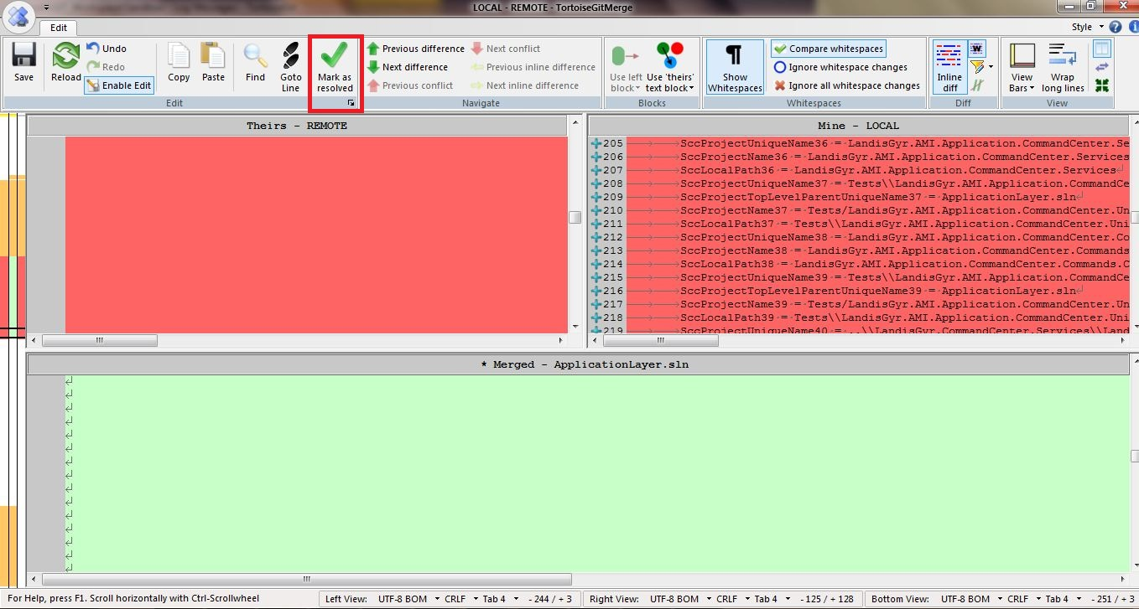
Select the block in which you want to resolve conflict.
Right click and select ‘Use text block from "theirs“ ‘ or ‘Use text block from “mine” , or manually make the changes.
Click on ‘Mark as Resolved’
Landis+Gyr Confidential Information

Slide 14
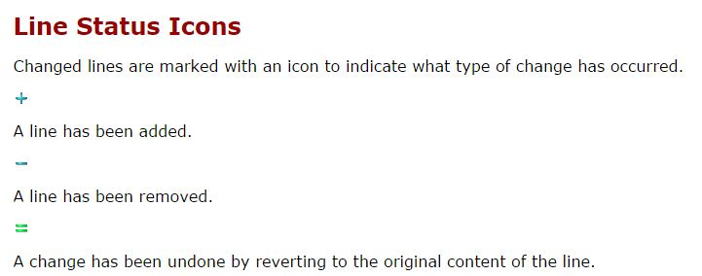

Landis+Gyr Confidential Information

Slide 15
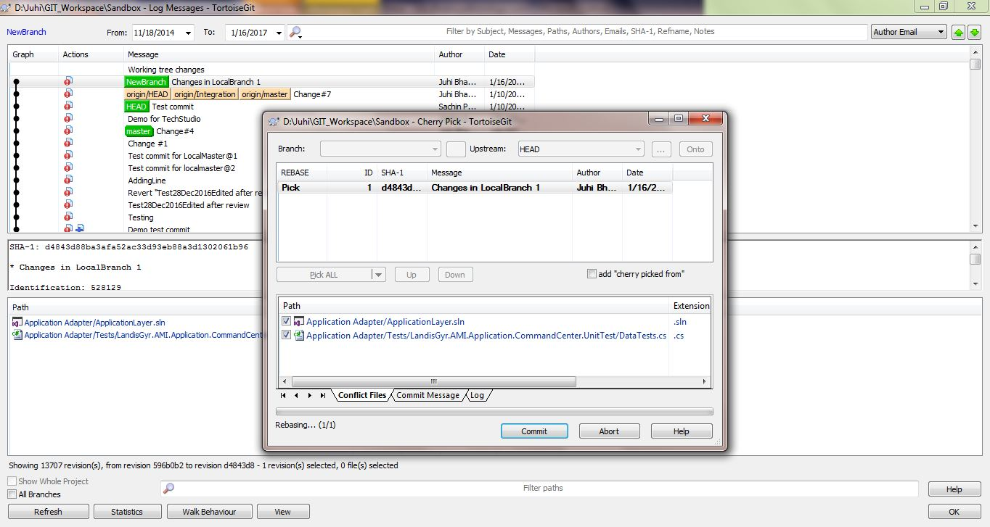
Close the file
Select Commit
Landis+Gyr Confidential Information

Slide 16
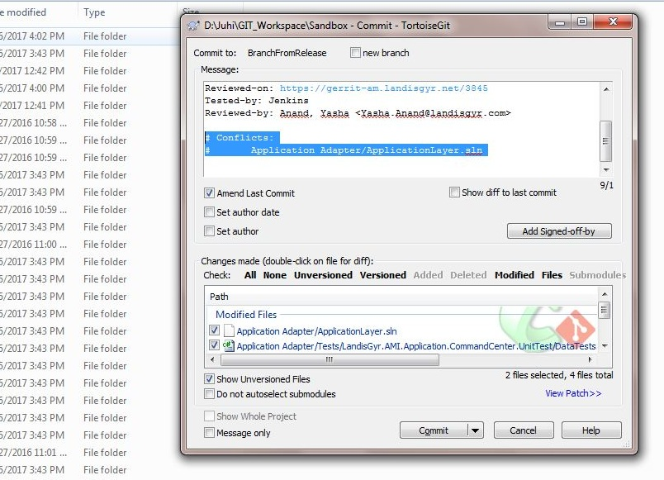
Commit your changes. Select amend last commit and remove the Conflicts from the commit message.
Perform Fetch and Rebase.
Landis+Gyr Confidential Information

Slide 17
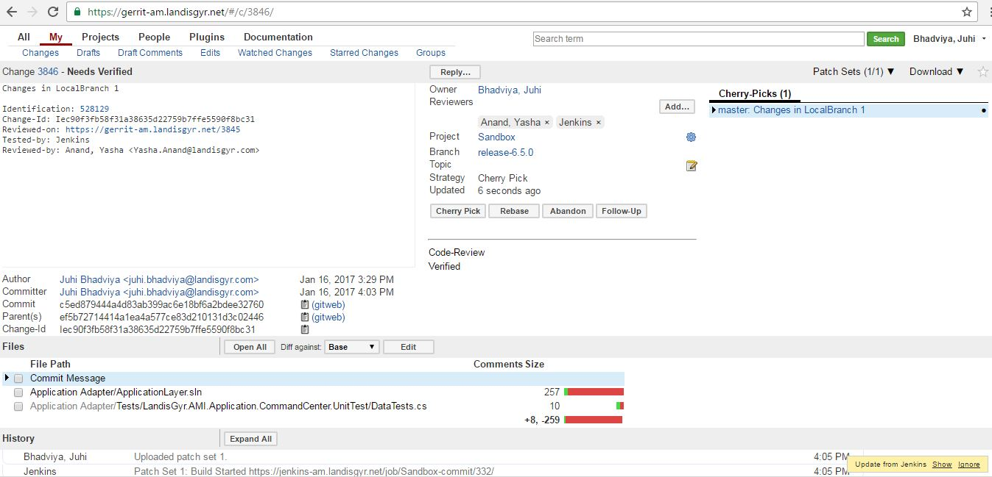
Push your changes to say release-6.5.0 branch.
Get your changes reviewed and Submit.
Landis+Gyr Confidential Information

